Slide 1


PGP-DATASCIENCE EDA MINI PROJECT

Slide 2
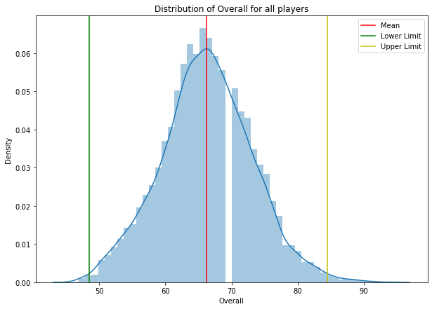
The graph on the right shows the distribution of overall of all the players.
The graph is normally distributed and the average lies right at the middle of the distribution.

Slide 3
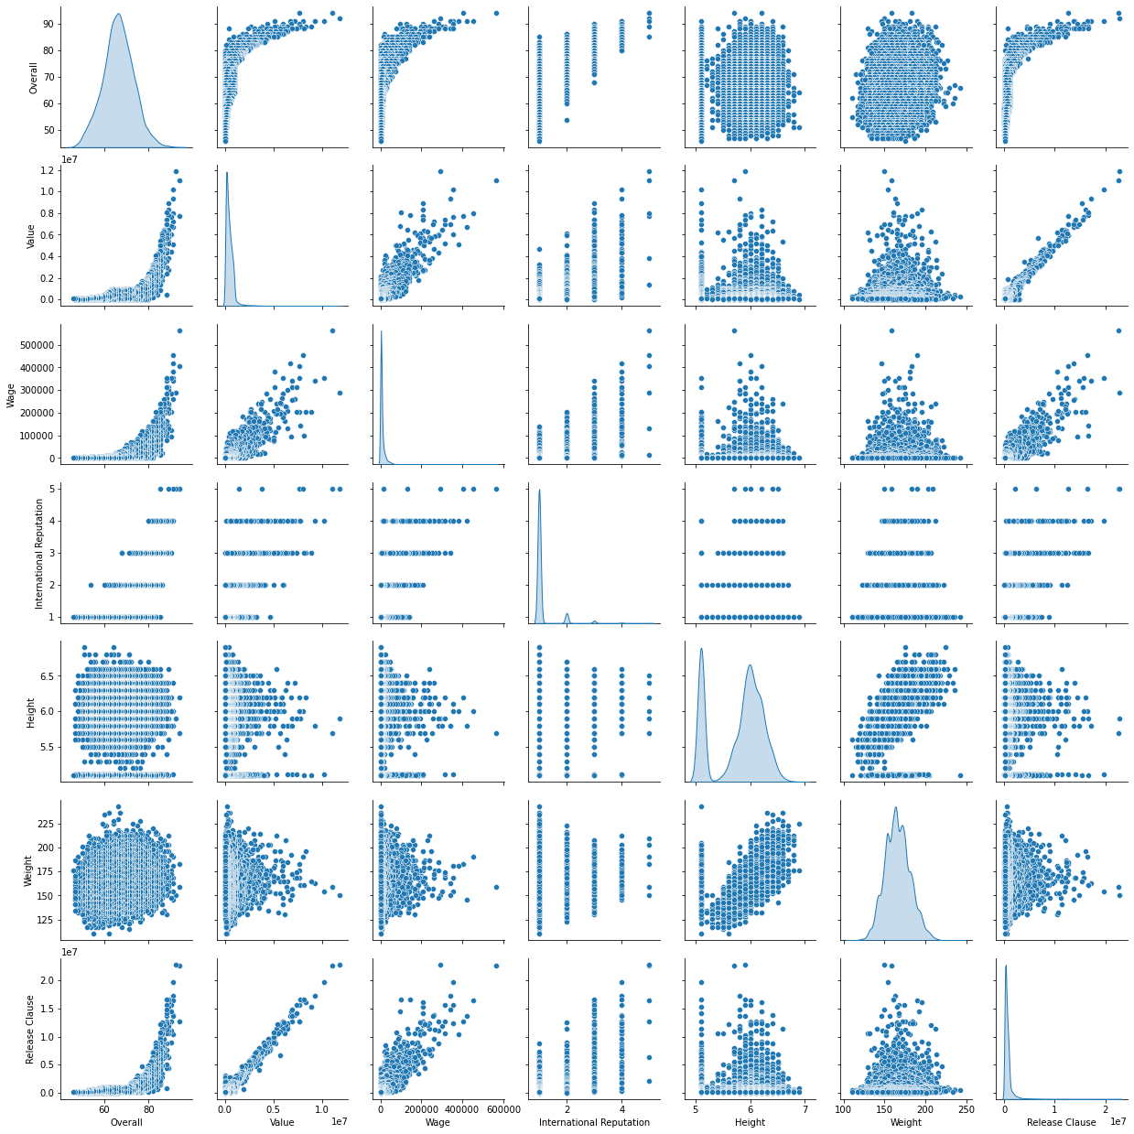

Slide 4
